Slide 1
Deep Reinforcement Learning from Self-Play in
Imperfect-Information Games
Johannes Heinrich and David Silver
Machine Learning, Artificial Intelligence, Computer Science and Game Theory, arXiv:1603.01121
Presenter: Ying-Yu Lin
Date: Sep.6, 2022

Slide 2
Abstract
Many real-world applications can be described as large-scale games of imperfect information. To deal with these challenging domains, prior work has focused on computing Nash equilibria in a handcrafted abstraction of the domain. In this paper we introduce the first scalable end-to-end approach to learning approximate Nash equilibria without prior domain knowledge. Our method combines fictitious self-play with deep reinforcement learning. When applied to Leduc poker, Neural Fictitious Self-Play (NFSP) approached a Nash equilibrium, whereas common reinforcement learning methods diverged. In Limit Texas Hold’em, a poker game of real-world scale, NFSP learnt a strategy that approached the performance of state-of-the-art, superhuman algorithms based on significant domain expertise.

Slide 3
Fictitious Play
Two-player zero-sum game
each player plays the best response to his opponent strategy
find the Game Value in an iterative way
converges to Nash equilibrium

Slide 4
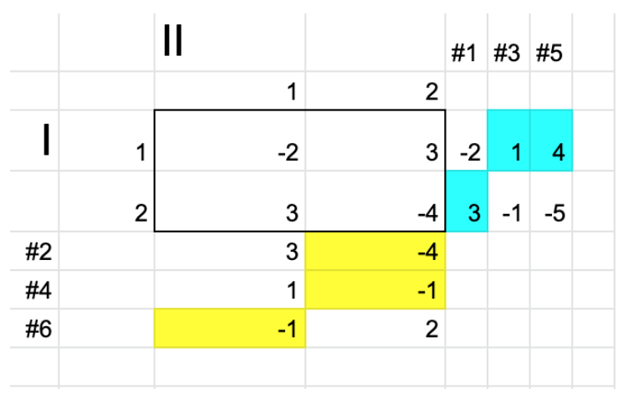
Fictitious Game
plays “1” with probability 7/12
plays “2” with probability 5/12
on the average will win 1/12

Slide 5
Fictitious Self-Play
Reinforcement learning to find an approximation of the best response
Supervised learning to update the average strategy

Slide 6
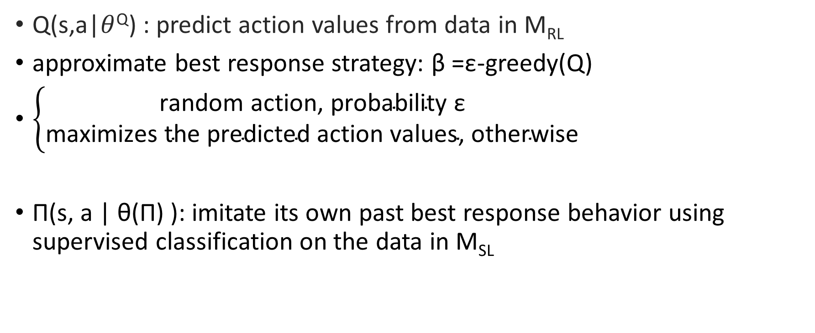
Neural Fictitious Self-Play
Q(s,a|$θ$^{Q}) : predict action values from data in M_{RL}
approximate best response strategy: β =$\text{ε}$-greedy(Q)
$\left\{\begin{aligned}\text{random} \text{action}\text{, }\text{probability} \text{ε} \\ \text{maximizes} \text{the} \text{predicted} \text{action} \text{values}\text{, }\text{otherwise}\end{aligned}\right.$
Π(s, a | θ(Π) ): imitate its own past best response behavior using supervised classification on the data in M_{SL}

Slide 7
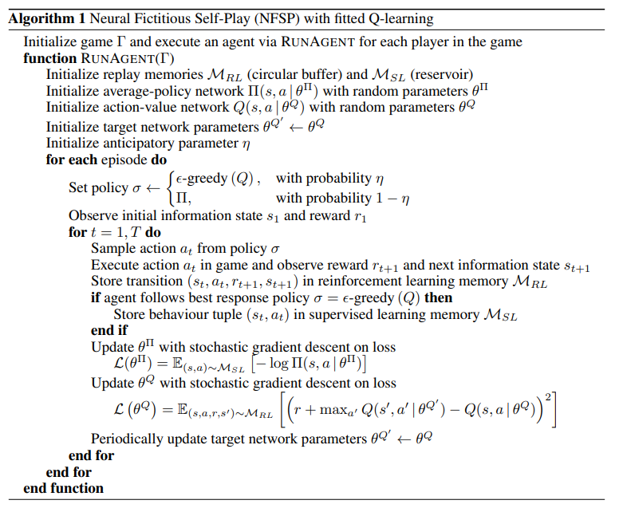
Algorithm
Notes:
定義策略 σ，使其成為概率為 η 的 ε-greedy(Q)，以及概率為 (1-η) 的 Π。
從 σ 獲取動​​作，在遊戲中執行，觀察獎勵 r(t+1) 和下一個狀態 s(t+1) 以及轉移 [s(t), a(t), r(t+1) , s(t+1)] 在 Mrl.
如果 σ 是 ε-greedy(Q)，則將 [s(t), a(t)] 存儲在 Msl 中。
使用 Msl 訓練 Π(s, a | θ(Π) )
使用 Mrl 訓練 Q(s, a | θ(Q) )
定期更新目標網絡權重 θ(Q') ← θ(Q)

Slide 8
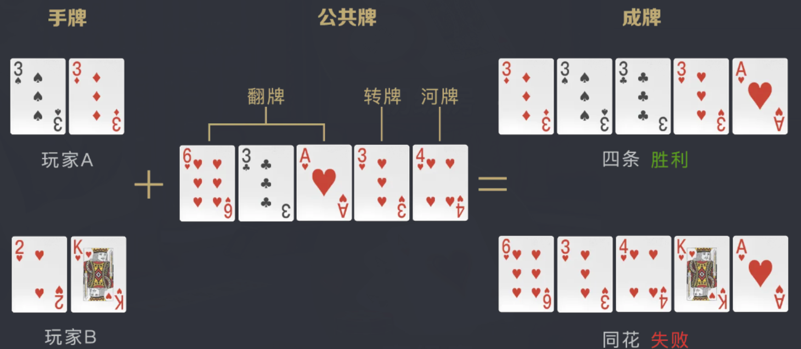
Texas Hold’em
Fold
Call
Raise

Slide 9
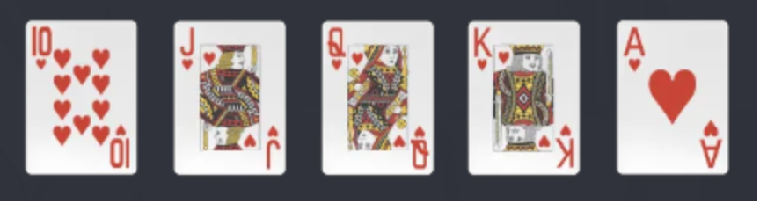
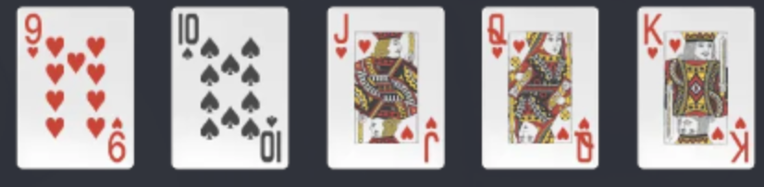
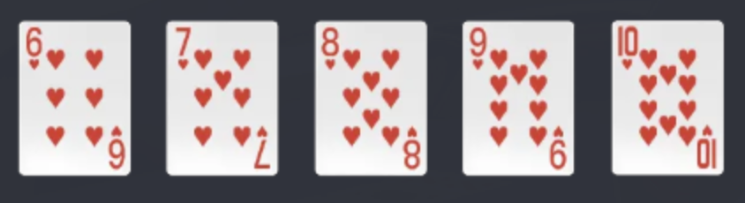
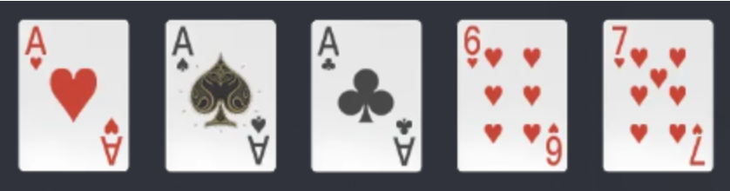
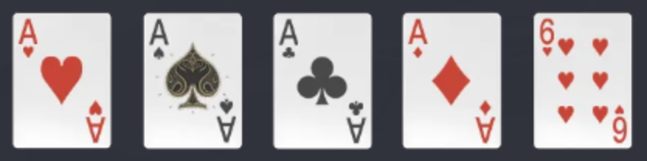
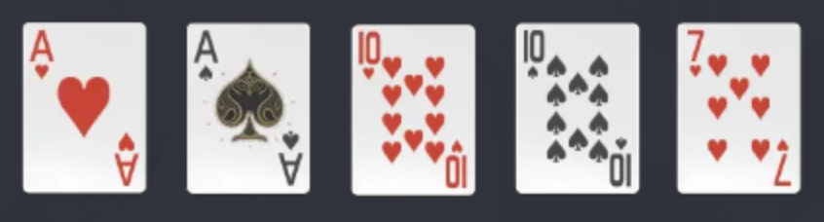
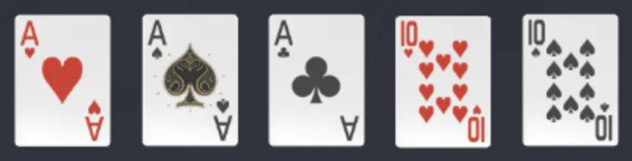
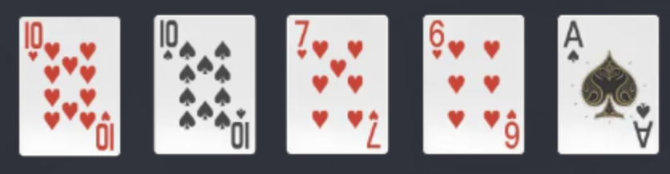
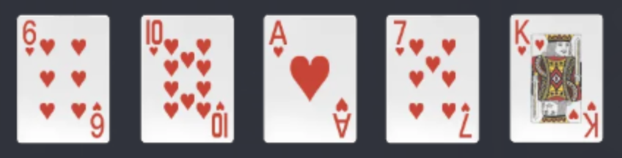
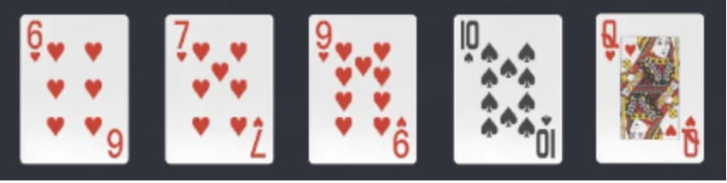
Texas Hold’em
1.皇家同花順 同一花色中 最大的順子 | 6.順子 花色不同的順子
2.同花順 同一花色的順子 | 7.三條 三張數值相同的牌 加上兩張單張
3.四條 有四張相同數值的牌 | 8.兩對 兩對加一張單張
4.葫蘆 三張相同數值的牌 加上一對 | 9.對子 一對加三張單張
5.同花 五張牌花色相同 | 10.散牌 五張單牌

Slide 10
Leduc hold’em
six cards: J*2, Q*2, K*2
2 rounds
0 to 2 raises per round
3 actions
288 information sets
Betting history{player, round, number of raises, action taken}
Encode as a vector of length 36 (2*2*3*3)

Slide 11
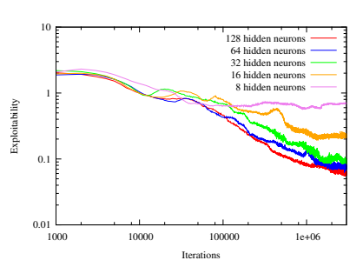
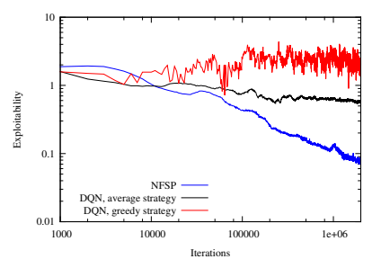

Experiment
Reinforcement rate : 0.1
Supervised rate : 0.005
η = 0.1
$\text{ε}$ = 0.06
(a) Varying network size
(b) Comparison to DQN

Slide 12
Limit Texas Hold’em
2 players
4 rounds
0 to 4 raises per round
3 actions
Betting history{player, round, number of raises, action taken}
Encode as a vector of length 80 (2*4*5*2)

Slide 13
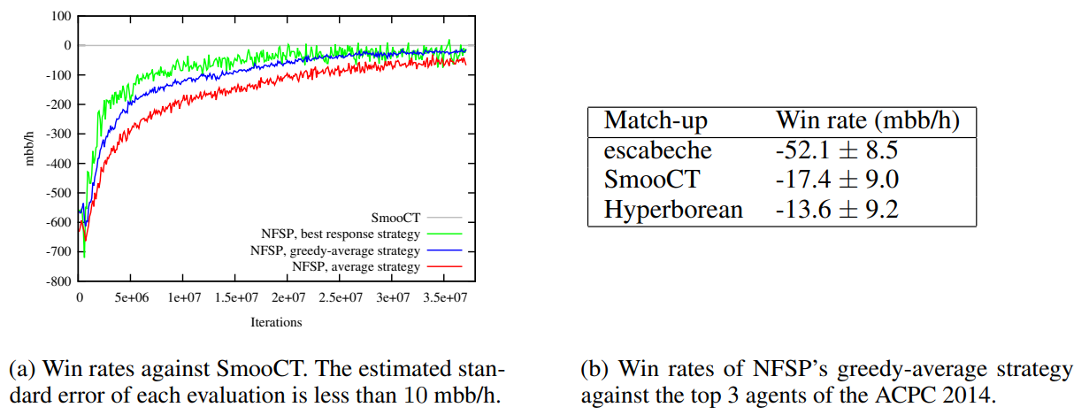

Experiment
Reinforcement rate : 0.1
Supervised rate : 0.01
η = 0.1
$\text{ε}$ = 0.08

